Slide 1


Slide 2
My perspective…
Every job in early childhood…
Former School Principal for early childhood – over 1,000 children ages 0-6
Part of the Evaluation Team on the Preschool Expansion Grant
My research examines early childhood education and bilingualism in early childhood
Experienced with the EDI

Slide 3
Examining School Readiness
School readiness at Kindergarten is a reflection of a child’s early experiences. The services, supports, and resources in a community have great impact on these early experiences. A new conceptualization of school readiness underscores what a community can do to prepare young children for school…

Slide 4
Early Development Instrument (EDI)
School Readiness at a population level
Measures school readiness before grade one
Has been used with over 200,000 children in Canada
Nationwide initiative in Australia
Over 18,000 children in the United States
Not diagnostic
Valid & Reliable
Holistic
Based on Teacher Observation – 104 Questions
Five Domains of Development
Analyses
  Percentiles and Mean Scores
  National Sample
  Instructional Program
  Additional Variables

Slide 5
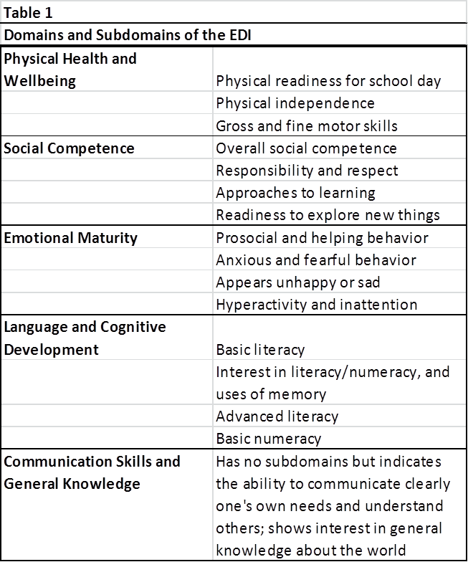
Domains and Sub-domains

Slide 6
Data from the EDI
Score in a 10 point scale by Domain
Percentiles & Categories
Percentages of Vulnerable & At Risk
Cross-tabs with other variables
Separate Special Education Students

Slide 7
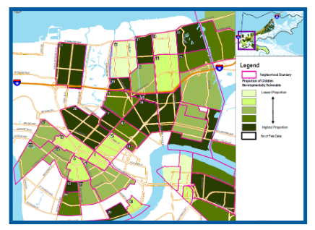
Mapping
Vulnerability
Census Track

Slide 8
Three New York Communities
Preschool Expansion Grant
First-year project – Data Collection
Second-year project – Designing an Initiative

Slide 9
Percent Scoring within Percentile Categories N=980

Slide 10
Percent Vulnerable by Domain – Comparison to the National Sample

Slide 14
Percent of Low-Income Children (N=604) Rated as “On Track-Ready for School” by Attendance in Full Day Pre-Kindergarten

Slide 15
Examples of Individual Findings
Community A | Community B | Community C
ELL/MLL students had higher rates of vulnerability in two or more domains; they had a high rate of poverty and low rate of Pre-K attendance. Bilingual instruction for ELL/MLL students is associated with lower rates of vulnerability in all domains. In one domain (Social Competence) the difference was statistically significant. On every domain, attendance in full day Pre-Kindergarten is associated with lower rates of vulnerability. | Children on free and reduced-price lunch were actually fewer low income children scoring as vulnerable or at risk than more affluent children in Language and Cognitive Development. MLLs rated as vulnerable or at risk compared to 30.4% of English speakers. In every domain, attendance in full day Pre-Kindergarten is associated with higher percentages of children scoring as “On Track – Ready for School” | Students scored highest in Language and Cognitive Development and lowest in Communication and General Knowledge. In every domain, approximately 30% of children scored as “Vulnerable” or “At-risk.” Compared to the national sample, children are less vulnerable in Physical Health & Well-being but more children score as “Vulnerable” in two or more domains.

Slide 16
Second-Year Project:
Designing an Initiative
Who “owns” school readiness?
Stakeholders
Building a Team
Implementation Team
Community Members
Five to eight parents of young children
Leaders in service delivery
Leader: Community Liaison
School Representatives
ECE Administrator
2 Prekindergarten Teachers
2 Kindergarten Teachers
Broad Trustees
Leader: School Liaison
Principal Investigator
Project Representatives
Liaisons at NYSED, CCF, CUNY PDI

Slide 17
A Year of Examination
Initiative Design
EDI Findings
Surveys
Public Data
Interviews

Slide 18
Where to begin?
What do surveys and interviews suggest?
A “doable” initiative
Targeting the entry point

Slide 19
A Logic Model
Resources
Activities
Outputs
Outcomes
Impact

Slide 20
Moving Forward…
Unveiling the Initiative
Tracking Progress
Collecting the EDI again

Slide 21
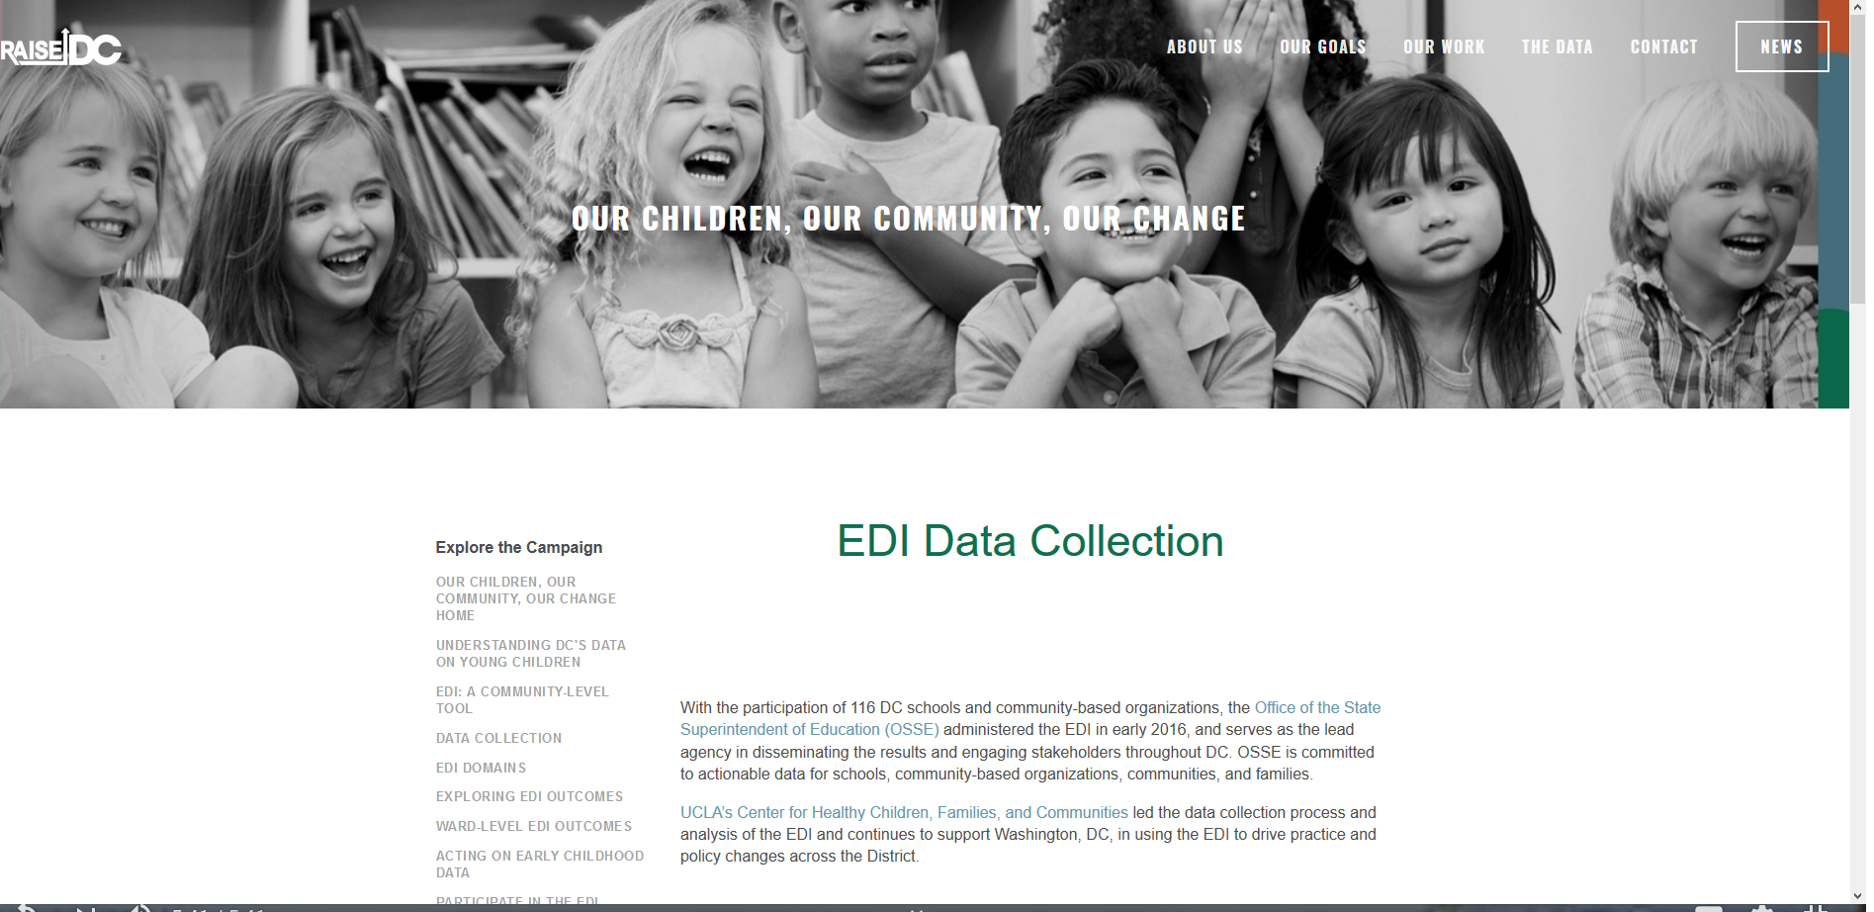
Examining New York
Regional Patterns
Rationale for Funding & Resources
Taking Action
Raise DC

Slide 22
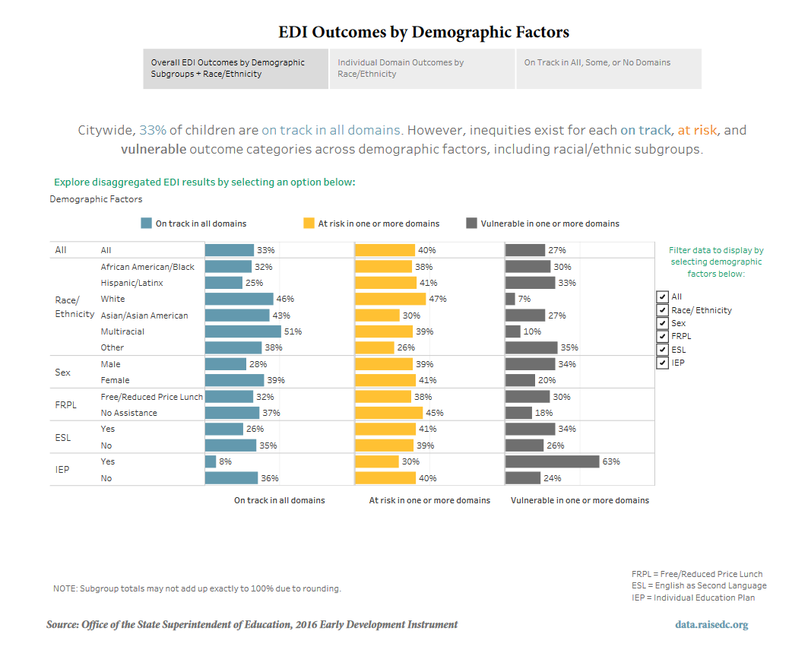

Slide 23
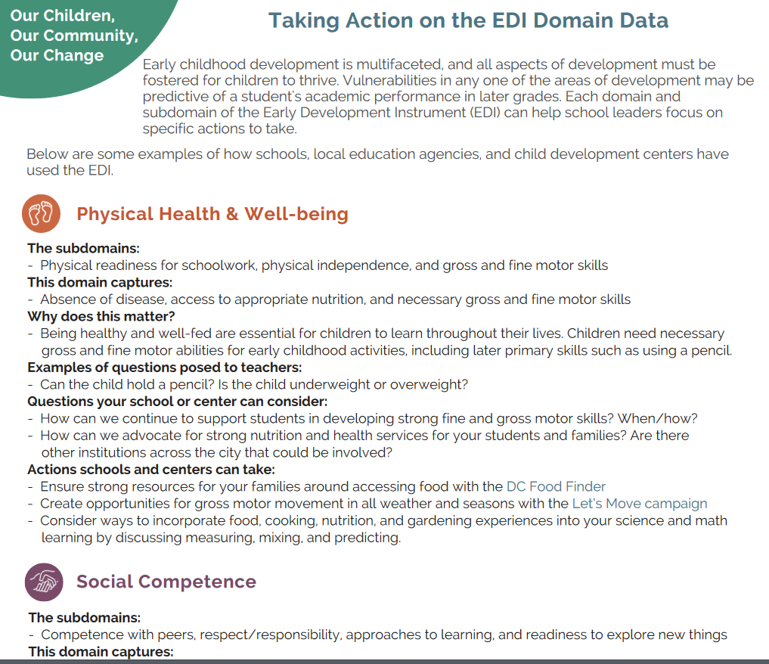

Slide 24
Discussion

Slide 25


